Slide 1
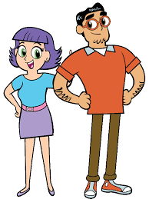
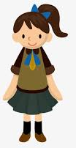

“Happy birthday, Princess!!!!”
Mom and Dad presented the large box to 12-year-old Tara with great pride.

Slide 2
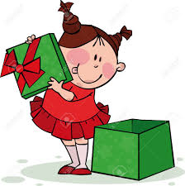
THANK YOU SOOO MUCH!!!!!!

Slide 3
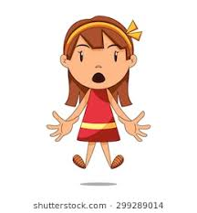
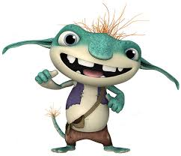
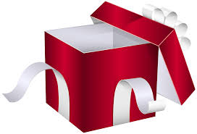
“oh ! what is it, Daddy?”
Tara squealed with surprise.

Slide 4
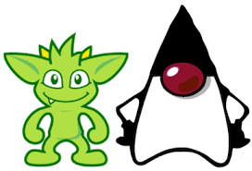
Standing in the the box, just barely 6 inches tall, was a tiny human-like figure.
.
Human but not human.

Slide 5
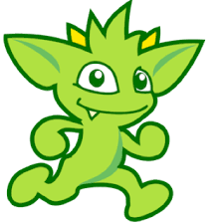
I am a gossip GREMLIN
I can squeak and dance!!
(A gremlin is a folkloric mischievous creature)

Slide 6
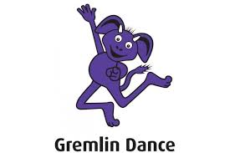
Tara named the gremlin Mystee.
Every time she called its name, it squeaked and did a dance.

Slide 7
Mystee was cute and cuddly and very very entertaining.
Tara adored him.

Slide 8
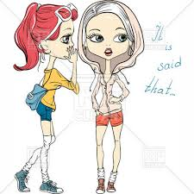
One evening, Tara was talking to her friend Aastha
“Astha, did you see what Jyoti was wearing?
She has such ugly clothes!”
Mystee jumped to his feet growled and grew LARGER

Slide 9
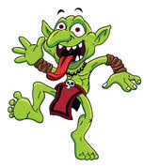
immediately there was a squeak and a jig and Mystee grew and changed…

Slide 10
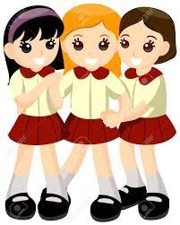
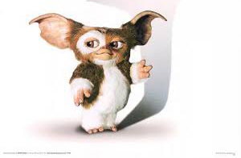
Next day Tara sneaked Mystee into her backpack and took him to school.
Oh, how her friends rushed to hold Mystee and pet him and tell him how cute he was.

Slide 11
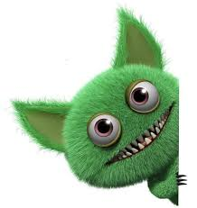
“Nikita called Kavya a dumb girl………….. ”
“Sandhya has ugly hair….
And then they started………
And with each tiny piece of gossip, Mystee did a little yip, did a back flip, danced and grew bigger and fatter.

Slide 12
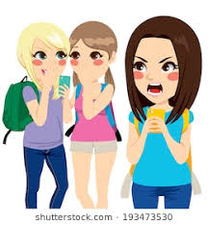
The gossip food streamed from every gathering of students….
“Nikita is this…..
“Sandhya said this…….
“Liasa did this….

Slide 13
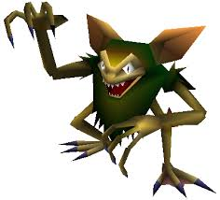
Mystee yelped, then danced and flipped and twirled
He was now nearly 3 feet tall and very different….
The gossips today were so good for him.

Slide 14
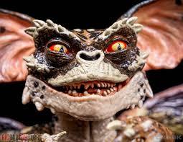
The students began to panic at the change in mystee’s appearance …..

Slide 15
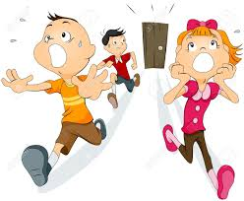
The frightened students rushed into the halls screaming......

Slide 16
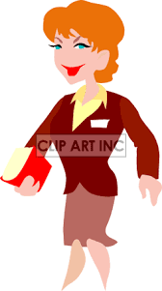
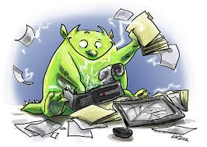
Suddenly, the principal came marching down the hall. ….
One look at the gremlin and she understood

Slide 17

“Arushi come here, tell the truth.”
Sorry aunty,Laisa didn’t cheat in the test. I lied. Laisa is a good person.”

Slide 18
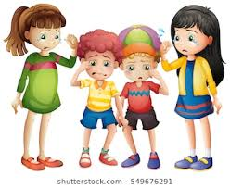
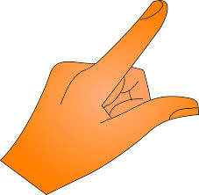
“Preeti, Jaswinder, Sandhya… tell the truth,”
The principal said

Slide 19
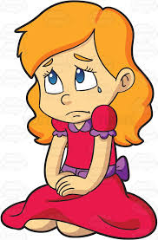
One by one the students stepped forward and spoke the truth, correcting their gossiping lies.

Slide 20
That was all it took.

Slide 21
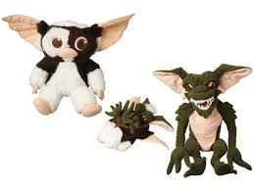
Mystee moaned fell back and did a forward flip and then just like that with a loud BLIP,

Slide 22
he transformed back to the lovable cuddly creature he was.

Slide 23
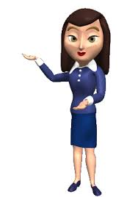
“hope you have all learned your lesson!” said the good principal

Slide 24
and with that, there was never again another gossip gremlin in Tara’s town.

